Slide 1

Clean Core Strategy for WRICEF Developments
Presented by: Pankaj Yadav
Date: 7th Dec, 2022

Slide 2
Agenda
Introduction about me
Basics of Clean Core
Strategy - WRICEF

Slide 3

Who am I?
“I am from India, SAP Techie with 11 years of experience, Current working in EY Consulting as a SCON, started my journey in plain ABAP->Workflow->WebDynpro/FPM->ABAP ISU->ABAP HANA->BW HANA->S/4HANA Developer->trying some stuff in BTP….(in-progress)…”
Hobbies: play with my kid, Movies/Series addict, Cricket, hangout with friends
Connect with me on Linkedln: (7) Pankaj Yadav | LinkedIn

Slide 4

“Clean diet makes your body healthy.. in a similar way.. Clean core makes your ERP healthy”
“Clean Core is a not a one-time activity, it’s a journey”

Slide 5

What is Clean Core and why its needed?
WHAT?
Clean digital is a methodology where extension are kept strictly separate from SAP standard
Leverage Key-user/In-app + ABAP Cloud(on stack) + Side-by-side extensions to its full extent as per customer need
Why?
Current developments have caused problems during upgrades or performance issues
Anyone wants to be cloud ready
Reduce TCO from custom code point of view
Able to infuse innovations at a faster rate on changing business requirements

Slide 6

How of Clean Core?
Follow SAP guidelines: Zero modification policy, Leverage modern extension, integration & automation options, back to standard, track SAP tech. updates
Coupling analysis for side-by-side approach, retire unused code, replatform (ABAP Cloud) and migrate old custom code in case of migration/conversion to S/4HANA
Follow extension approach for greenfield(In-app/ABAP Cloud→Side-by-Side→Classic)
Use of whitelisted/Released APIs if possible
Build wrapper APIs if standard are not available to minimize technical debts.
Keep a track of deviation from best practices

Slide 7

Recommended CC approach
for WRICEF
Assumptions: Business is on ECC or S/4HANA(OP/PCE) or planning to move to S/4HANA(OP/PCE), S/4HANA OP versions plays a vital role in deciding when to use what for effective CC

Slide 8

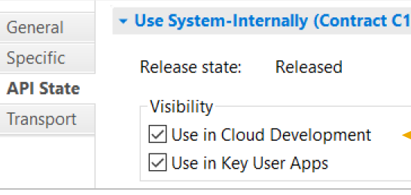
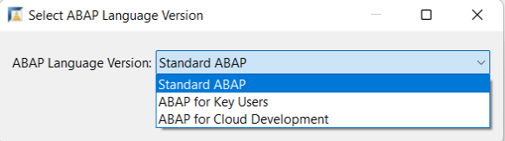
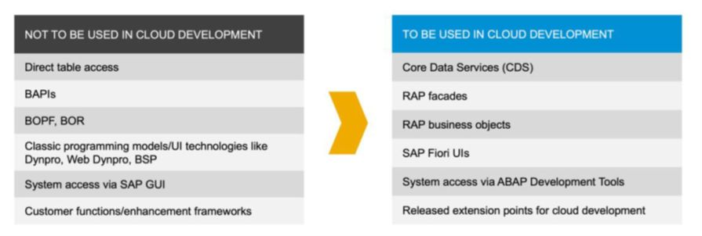
General Rules…
Whitelisted API if possible, if not then ask from customer influence programs
Wrapper APIs
Restricted ABAP if possible
ATC(SAP_CP_READINESS, ABAP_CLOUD_DEVEVLOPMENT_DEFAULT) and quick fixes in ADT
You can’t avoid modifying SAP systems but do it gently ☺ i.e. don’t write direct code, build custom BADIs and wait for released extension points also
Exploit API Business hub, free-tier services if BTP in picture
Break them but do know what, why and where are you breaking, track tech. debt.

Slide 9

Workflows
S/4HANA Flexible Workflow
      Preferred way of building workflows in S4 as SAP’s innovations will happen for this in on-prem world
      Leverage standard SAP workflows and enhance with in-app or side-by-side if needed
      Give more power to business user, less dependency on IT(i.e. clean core ☺ )
      Custom scenarios can be built
SAP Build – Process Automation + Workflow Management
Suitable for building de-coupled and intelligent workflows with access given to outside users
Use of pre-built solutions from API business hub(Free) or SAP Store
Business user can configure and automate with less dependency on IT(i.e. CC again)
Keep in mind the costing of PA or workflow service in BTP, try with free-tier first
SAP Business Workflow + SAP BPM (Last resort for greenfield)
Continue using these options if no need of FW or limitations in case of migration
If custom objects like classes, FG are going to use or migrate, try to write/refactor with restricted ABAP for stability

Slide 10
Reports
Read only app:
ABAP Cloud(On stack) Unmanaged/Managed query (Preferred Way)
Custom CDS view based OData with FIORI
Custom SEGW OData with FIORI
ALV on top of CDS or AMDP( GUI Fan ☺ )
Transactional app:
ABAP Cloud(On stack) Unmanaged/Managed BO(Use strict mode if possible)
SAP Build Apps aka Appgyver on top of S4 APIs (Focus on business user but save time for developers as well if developer is PRO ☺)
Side-by-Side app:
Custom report on top of S4 with the use of BAS, connect released APIs or events
Analytical app:
Custom analytical query inside S4 stack
Analytical list page report prepared in BAS on top of released APIs
SAC(for big reporting solutions, connect with multiple sources, DWC in picture)
Classic: can’t leave old gold ☺
OOPS ALV
WebDynpro/FPM
Module Pool

Slide 11
Interfaces
Whitelisted/Released APIs:
Standard SOAP or ODATA API, directly integrate with 3rd Party or Integration capabilities
Extend SOAP or ODATA with In-app extensions
Custom RAP API
Custom OData on top of custom CDS views
Wrapper RFC on top of BAPI with custom logic
Event based:
Event Mesh with integration suite i.e. CPI or consume via CAP/RAP API
Standard IDOC

Slide 12
Conversions
Migration Cockpit(Most preferrable)
Custom ABAP cloud application to upload data via RAP facades or wrapper APIs
Data replication into BTP(if a custom process needs to be developed, separated from ERP)
Custom programs, make sure creating released/wrapper classes/FMs if possible
LSMW
BDC(Least preferrable)

Slide 13
Enhancements
In-app/Key user extensions
Encourage use of in-built LCNC tools with minimal coding, easy to maintain and upgrade safe
Preferred way to start with clean core
RAP Extensions
Extend DT, CDS and Behavior
Checkout standard RAP BO interface in API Hub under developer extensibility
Released BADIs from SAP or custom one’s
Exits, implicit, explicit etc. – Do it if nothing works but write custom BADI, release it
Extend with BTP(for very specific purpose i.e. send data to some BTP App or run CPI IFlow)

Slide 14
Forms
S/4HANA Output Management
NACE
ABAP Cloud application using adobe forms
BTP application with forms service

Slide 15
Challenges & Possible solutions of CC implementation
Upskilling of ABAP developer:
RAP
Tracking SAP technologies via Free learning resources like learning.sap, community, open.sap, TechED etc.
Understand personas
Skills of S/4HANA Stack:
Start small, like try to write restricted ABAP code in program DEMO_ABAP_VERSIONS(go inside this program and check how its doing ☺ )
Find whitelisted/released APIs in S4
ATC variants with respect to cloud
Aware of upgrade stable options like key-user extensions in SCFD_REGISTRY, enable extensibility apps from Day 1
Knowledge of BTP:
Discovery center
Developer.sap.com

Slide 16
THANKYOU

